Slide 1
COD3BR3KR
FINAL PROJECT REPORT
Diverse Engineers
Abdul Alqahtani, Alex Calis, Jacob (Shijie) Liu
12-20-2018, 6:15PM

Slide 2
Project Info (Matrix)
Team Members | Roles | Hours spent
Abdul Alqahtani | Architecture Diagram SRS Development (coding) User Guide/User Mgm table | N N N N
Alex Calis | Architecture Diagram SRS Doc Development (coding) PP Presentation | 2 8 8 6
Jacob (Shijie) Liu | Architecture Diagram SRS Development Developers Guide | 4 8 40 8

Slide 3
Project Info (Team Operation)
Meetings: Team occasionally met up to discuss project details, progress, and to delegate work. All members contributed to delegating work and choosing assignments
Communication: Team communicated primarily via email, but sometimes via phone calls, texts and meeting in person.

Slide 4
Project Info (Development Methodology)
The team used a mix between Waterfall and Agile methodologies.
Waterfall:
Methods used: Initially followed steps of: requirements, design, implementation, then deployment.
Advantages: Structured, easy to delegate work, requirements were defined first so initial development was straightforward.
Disadvantages: Too rigid in that any requirement change made we had to update the SRS and update code
Agile methods:
Methods used: after initial waterfall approach, we used agile to handle updates to requirements and easy to get client feedback
Advantages: Good when requirements changed since code was not finished yet. Demo (prototype) helped with changing/fixing features that may not have been spotted otherwise until the end (like decrypt output box changed from 300 char limit, and highlighting tabs feature added)
Disadvantages: Often changing documentation that was already complete (such as SRS) since updates were constantly made. Prevented the development of documentation such as User Guide or Developers Guide since only at the end would these be complete.

Slide 5
Project Info (Tools used during development)
The team used the following tools during this project effort:
Microsoft Visual Studio Community 2017
Visual Studio GitHub Extension and GitHub Desktop Client for Source Control Management
Visio 2016, StarUML and Umlet for design documentation

Slide 6
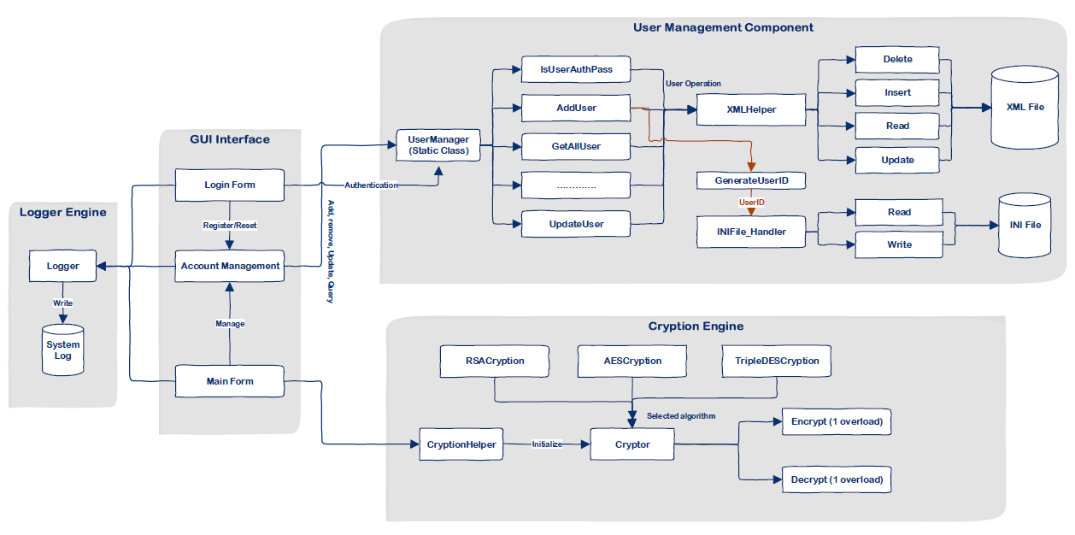
System Architecture Design

Slide 7
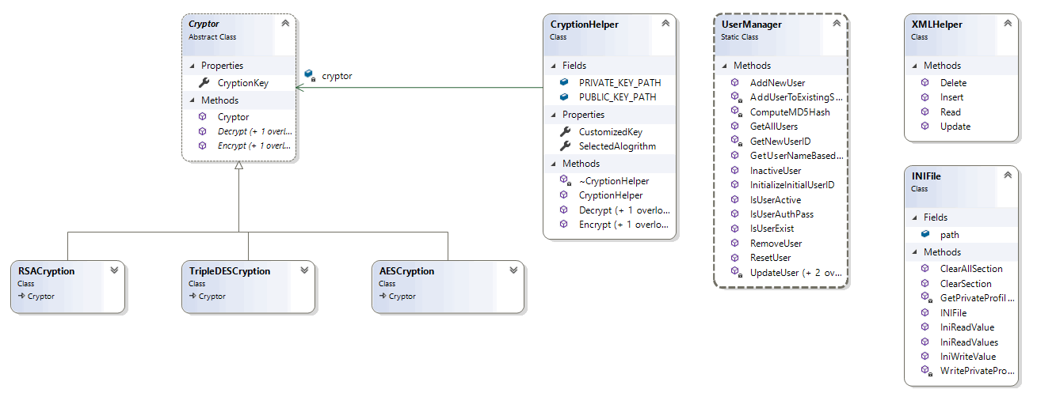
Class Diagram

Slide 8
Accomplished Work
What we produced:
A fully functioning, cryptographic module that implements 3 algorithms for both encryption and decryption, supporting both text and file input and output (RSA does not support File Option).
User Authentication and User Management with XML File.
Ability to handle various file types, Text Documents(TXT, WORD) and Binary Files(PDF, JPG, EXE).
A logging mechanism to track activity and error events of the system.

Slide 9
Accomplished Work cont.
How good is it?
Input error handling:
Log in form restricts authentication to valid accounts and warns users if unsuccessful log in attempts were made.
Log in provides an easy place to generate a new user account, which is protected against duplicate user accounts and incorrect password matching
Main form protects again invalid input (such as can’t encrypt/decrypt, >300 character input, key field missing) plus greying out non-valid items
User Management prevents duplicate users and prompts user to make sure they want to delete a user.
The system is protected with numerous try/catches and null pointer checks to prevent unexpected system crashes.
Logging helps identify errors or info to strengthen system health.

Slide 10
Accomplished Work (cont.)
How big is the system?
Number of classes: 12
Lines of code: 1,887
Hours of effort: ≈ 25 hours
Existing codebases: log4net (package), algorithm classes: AES (150 LOC)/Triple-DES (150 LOC)/RSA (120 LOC)
What we used: C# under Visual Studio IDE
Platforms: Windows 7/10

Slide 11
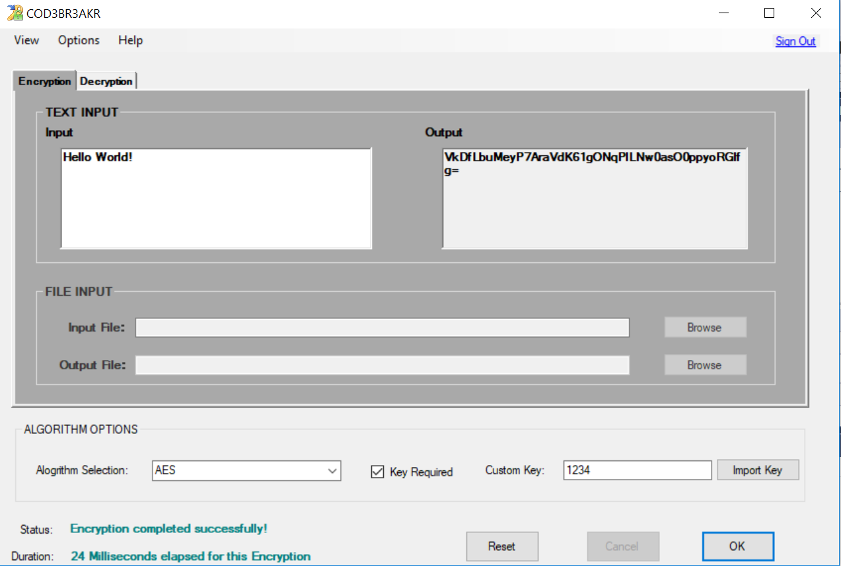
Our Product
UI: Encryption tab is greyed
Feature: String input and string output
UI: Clear separation between input options
UI: All grouped texts (string/file input and string/file output, alg selection and key, status and duration, etc.) are all formatted the same (font, size, bold, caps, etc.)
Feature: File input and file output
Feature: Algorithm selection (3 options) and custom key input

Slide 12
Lessons Learned
Things that went right
Group participation
Combining methodologies (agile and waterfall)
Delegated work often
Things that went wrong
Work almost always done separately, so immediate feedback is not possible, and also work may be duplicated if every detail is not fully delegated.
Communicating during busy times (such as work hours) on pressing matters.
What we’d do differently
Meet up in person more often so everyone is on the same page and effort moving forward is well understood.
Provide phone numbers for quick communication early in the process.

Slide 13
DEMO

